Slide 1

Saga Communications
Recruitment Campaign
Best Practices

Slide 2
Overview of Services
We are an end-to-end provider of radio & digital marketing services. Whether you're looking for a turn-key managed strategy, an independent audit, or services specific to a short-term campaign, our experience and approach are sure to prove to be a valuable asset.
Our in-house services include:
- Web Design & Development
- Search Engine Optimization
- Search Engine Marketing (PPC)
- Social Media Marketing
- Digital Content & Video
- Display Advertising
- Contextual / Behavioral
- IP Targeting / Addressable
- Device Targeting
- Custom Email Blasts
- WAZE Ads

Slide 3
Recruitmenting In A Competitive Market
In today’s competitive market, recruiting and retaining the right employees requires a comprehensive strategy! There are multiple factors to consider when planning a recruitment campaign in a tight labor market to reach qualified candidates for your open positions.
Best Practices For Successful Recruiting
Enticing Offer: Why should someone want to work for you? Examples include: benefits, flexible schedule, paid leave, competitive salary, company culture, opportunities for advancement, etc.
Engaging Creative: Eye-catching creative effectively conveys your enticing offer and includes a strong call to action which encourages potential candidates to learn more about your open position and apply.
Strategic Targeting and Advertising Tactics: We have several options to make sure your ads are shown to the right audience.
Simple Application Process: Ensure your online application is user-friendly, and as efficient and painless as possible to increase your conversion rate.

Slide 4




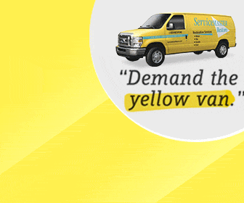

Creative Services
Creative can make or break a recruitment campaign! It's important to make sure your recruitment ad includes enticing messaging and a strong call to action. Especially in today's market, you have to give someone a good reason to consider leaving their current job to come work for you. We offer creative services to elevate the success of your recruitment campaigns.
Messaging To Consider For Recruitment Ads:
Sign On Bonus
Paid Leave
Flexible Schedule
Benefits
Competitive Salary
Career Advancement
Recruitment Ad Examples:

Slide 5



TACTIC RECOMMENDATIONS
We have several targeting options and tactics available to make sure your ads are shown to the right audience.

Slide 6
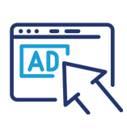
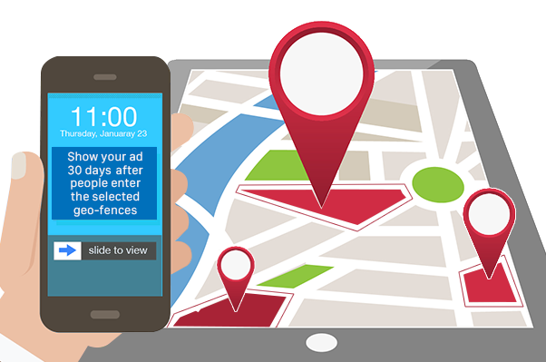
Geo-Fencing
Target your competitors employees and build awareness of your open positions as they live out their digital lives online.
How Does Geo-fencing Work?
Step 1: A virtual boundary is drawn around a physical location (ex: a competitor's business).
Step 2: A user enters the geo-fenced location.
Step 3: The user is served ads from the geo-fencing campaign for up to 30 days
Benefits of Geofencing
Geo-fence technology enables you to capture audiences through custom targeting shapes around businesses, street and highway boundaries, municipalities, etc.
• The most reliable way to target mobile users
• Pinpoint accuracy
• Granular localization via custom shapes & sizes
• Boost mobile performance and reach
• Retarget customers who visit or commute through any geo-fenced location
• Track off-line or “last mile” conversions to measure your campaign’s effectiveness
• Leverage targeted campaigns only to users within a predetermined physical
proximity to your business or your competitor’s business

Slide 7
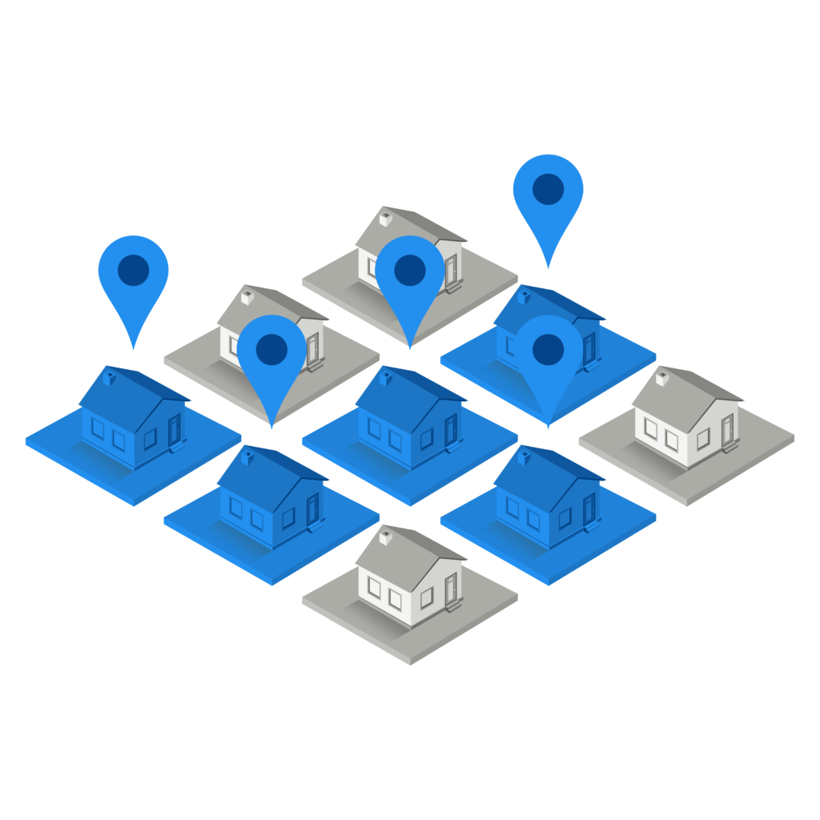
Addressable Geo-Fencing
Target your ideal employees and build awareness of your open positions as they live out their digital lives online.
How Does Addressable Geo-fencing Work?
Step 1: Target your mailing list OR build a curated list based on demographic targeting
(zip code, household income, occupation, education, etc.)
Step 2: Devices are captured at the address using platline data
Step 3: The users are served ads from the addressable geo-fencing campaign
Benefits of Addressable Geofencing
Addressable Geo-fence technology offers:
• The most reliable way to target users on various devices in your target demographic
• Pinpoint accuracy & localization via platline data
• Anticipated 90% match rate for mailing lists​
• Retarget customers/prospects on your mailing list
• Foot traffic attribution to measure your campaign’s effectiveness
• Cross device execution

Slide 8
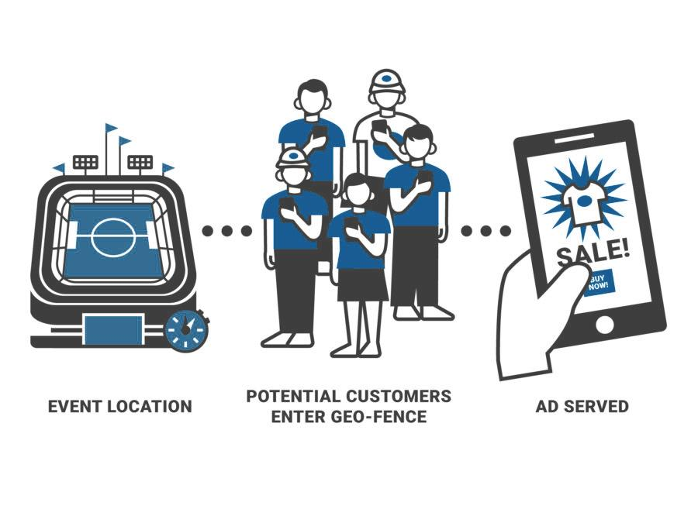
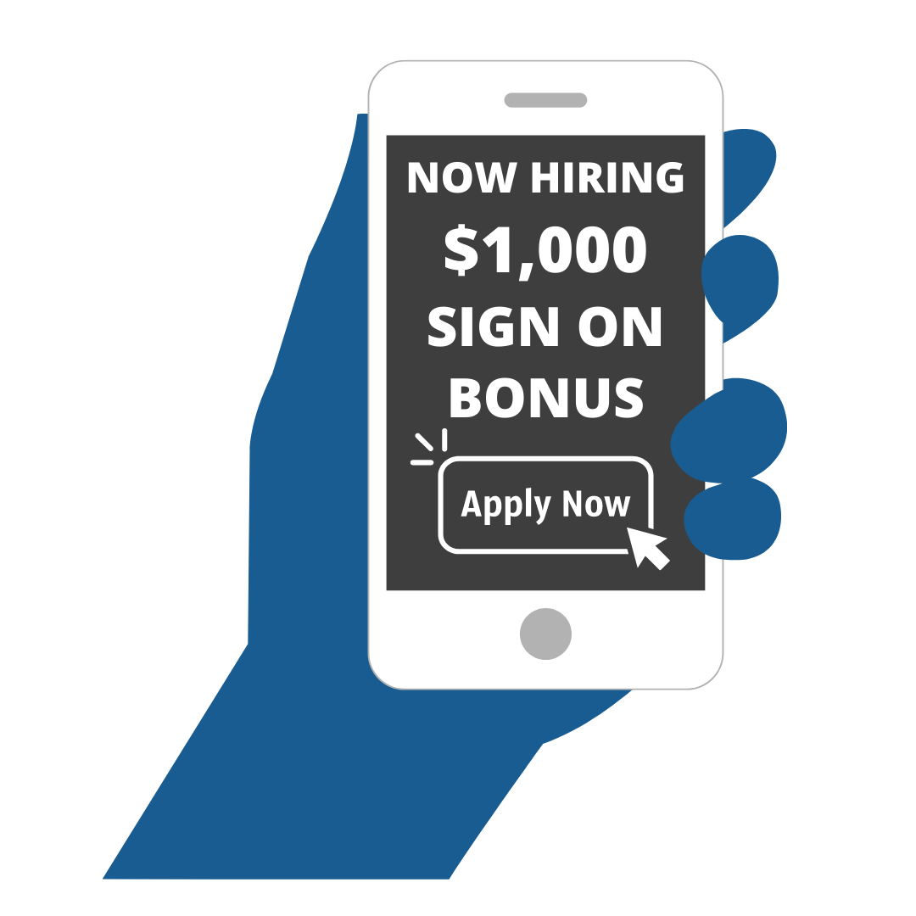

Event Geo-Fencing
Target audiences from specific events and serve them ads to brand your business and build awareness of your open positions.
How Does Event Geo-fencing Work?
Step 1: A virtual boundary is drawn around a physical location for a specific period of time. (ex: a job fair)
Step 2: A user enters the geo-fenced location during the event.
Step 3: The user is served ads from the geo-fencing campaign for up to 30 days.
Benefits of Event Geofencing
Event geo-fence technology enables you to capture audiences through custom targeting shapes around job fairs, concerts, sporting events, conventions, and other event types.
• The most reliable way to target mobile users at specific events
• Pinpoint accuracy
• Granular localization via custom shapes & sizes
• Boost mobile performance and reach
• Retarget customers who attend an event
• Track users who visit your store after seeing an ad to measure campaign effectiveness
GEOFENCE
JOB FAIR OR OTHER EVENT
POTENTIAL APPLICANTS ENTER GEOFENCE
RECRUITMENT
AD SERVED

Slide 9


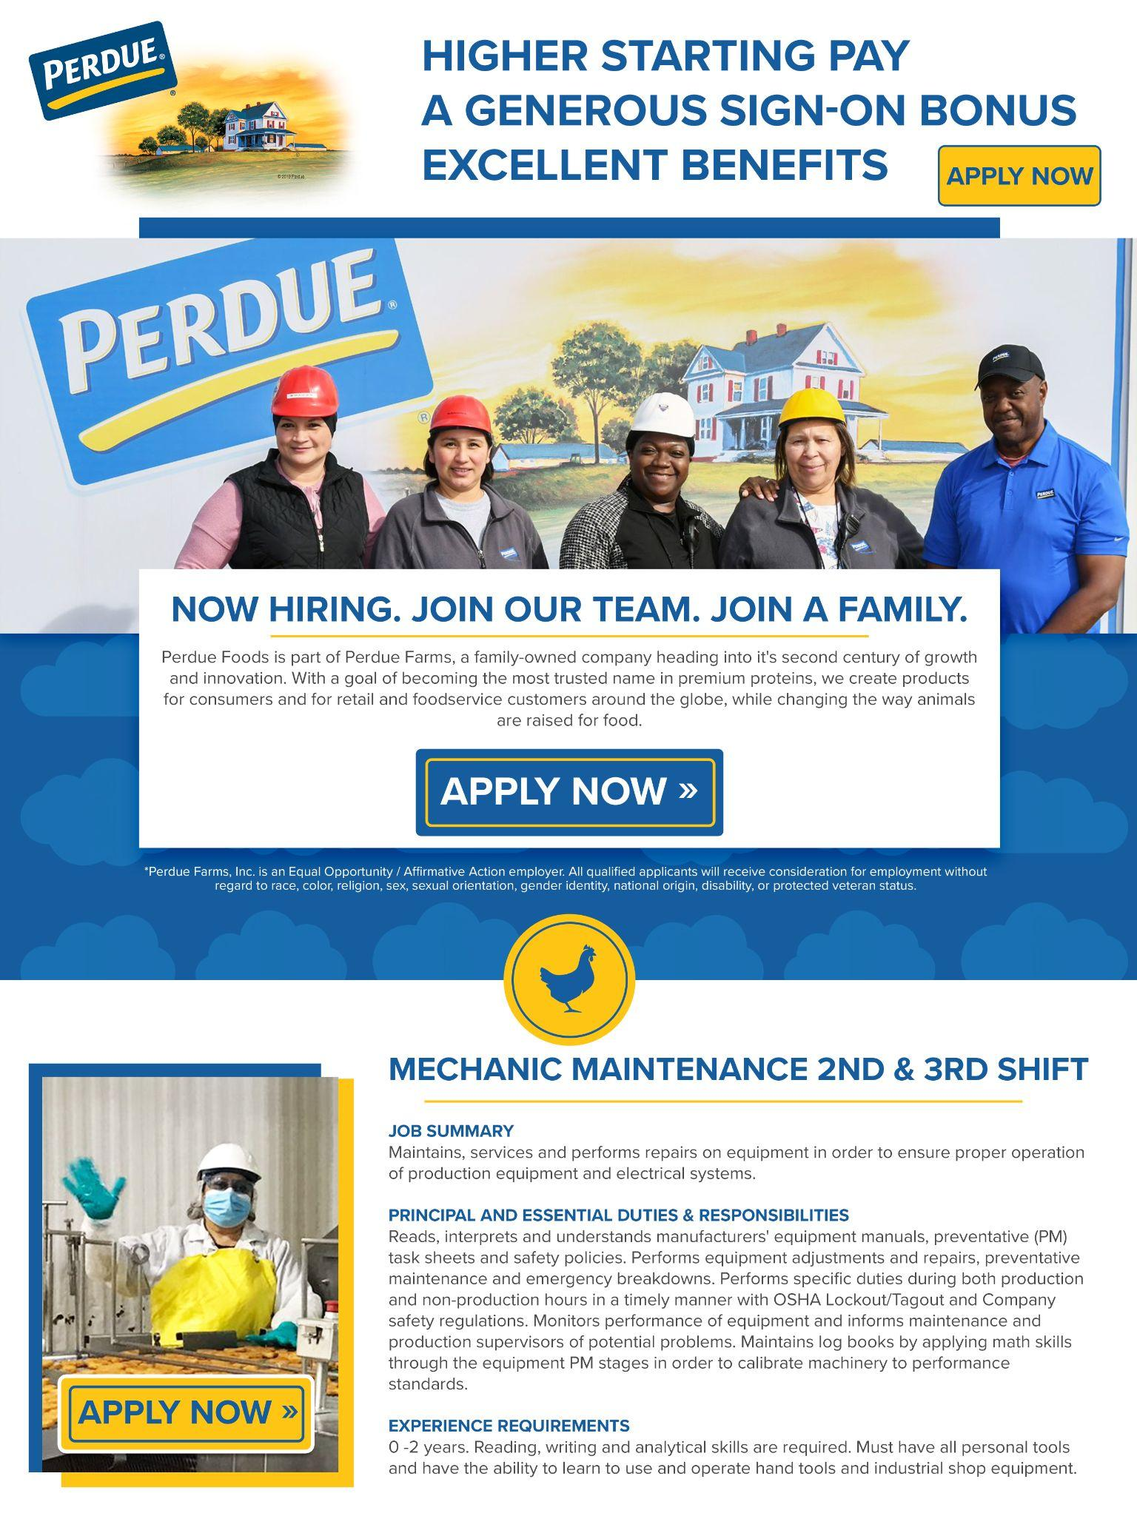
Email Blast
WHAT?
A digital marketing strategy is used to send emails and develop relationships with prospective applicants. An effective email marketing strategy converts prospective applicants into employees.
WHY?
According to Optinmonster, 58% of people check their email before social media. And according to Beamery, 85% of recruiters rely on email as their top channel to contact and build relationships with talent.
• Higher guaranteed click through rate • Additional traffic to your website • Increased conversion rates
• Easy-to-understand analytics and reporting • Hyper-target your audience where they are engaging most
• Connect with an audience that has expressed interest • 500+ Data Qualifiers to target for the outbound email marketing
TARGET OPTIONS
GeoGraphic:
City, County, Zip Code
PyschoGraphic:
Habits, Hobbies, Values
DemoGraphic:
Age, HHI, Credit, Etc.
Behavioral:
Website Visits, Search Terms
Occupation: Career change interest, current occupation, employment status, etc.

Slide 10
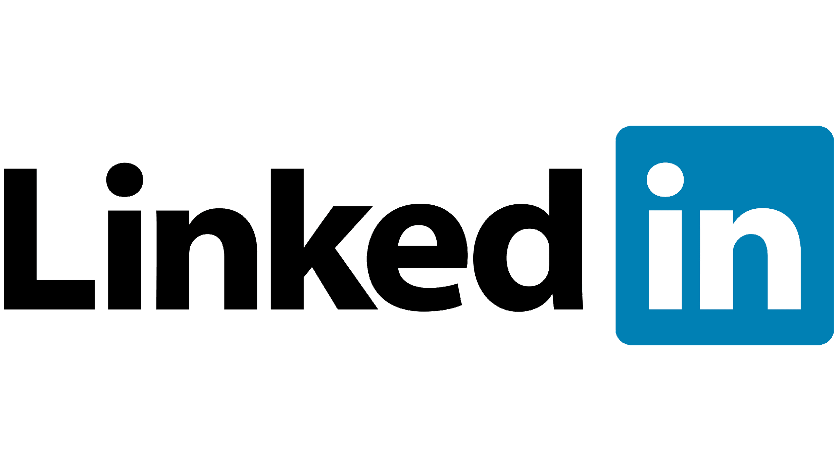


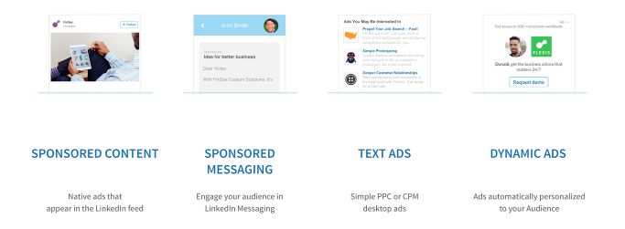
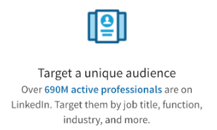
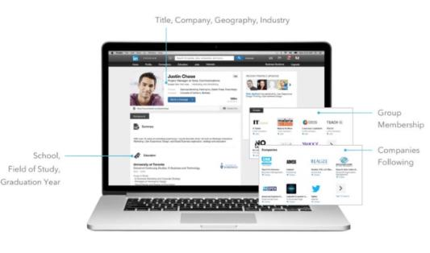
Promote your business with LinkedIn ads
Reach your ideal customers on the world's largest professional network.
Advertising on LinkedIn helps businesses of any size achieve their goals.
How LinkedIn ads Targeting Works

Slide 11
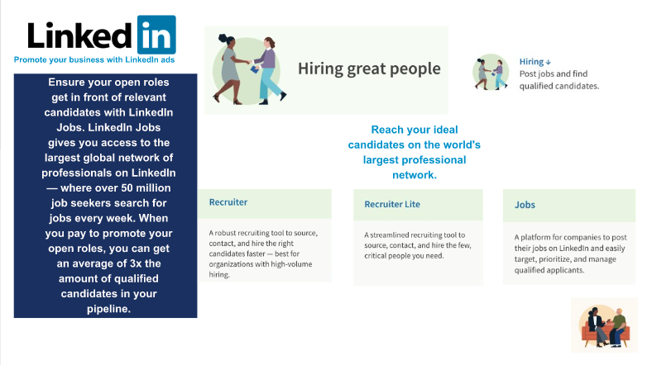
Promote your business with LinkedIn ads
Reach your ideal customers on the world's largest professional network.
Advertising on LinkedIn helps businesses of any size achieve their goals.
​Spread the Word about your Job Opening
​Take Advantage of a Wide Applicant Pool
​Review and Respond to Applications on the go
​Reach Qualified People by Promoting Your Job Post

Slide 12

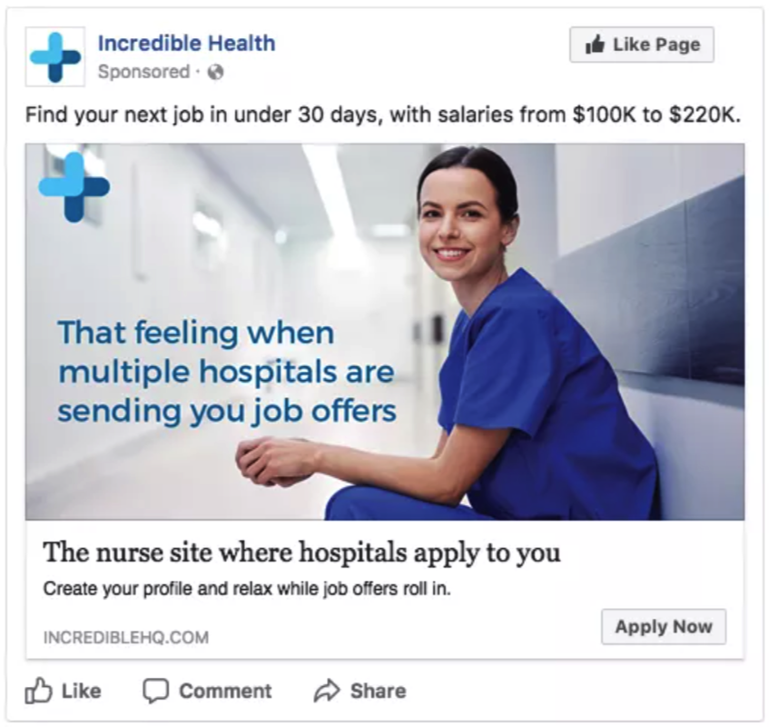
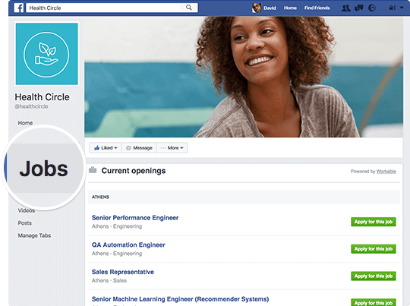
Find The Right Applicants For Your Job Opening
Facebook recruitment offers a great, but underutilized opportunity to proactively search for candidates. Did you know that you can use Facebook as a proactive sourcing tool? You can find potential candidates using Facebook search option - and you don't even need to have a company Facebook page to do it
​Spread the Word about your Job Opening
​Take Advantage of a Wide Applicant Pool
​Review and Respond to Applications on the go
​Reach Qualified People by Promoting Your Job Post
1 in 5
CANDIDATES CAN APPLY
MANAGE APPLICANTS
SCHEDULE & HIRE
One in five minutes on mobile is spent on Instagram or Facebook. That’s more than the next 10 mobile platforms combined!
Candidates can easily apply for your open position on your Facebook Page and job posting, without leaving the Facebook App.
Keep track of applicants with the jobs management tools where you can easily organize interviews and manage the status of applications.
Through your Facebook Messenger Portal you can easily schedule times to interview and move to the next steps for hiring the best candidate

Slide 13
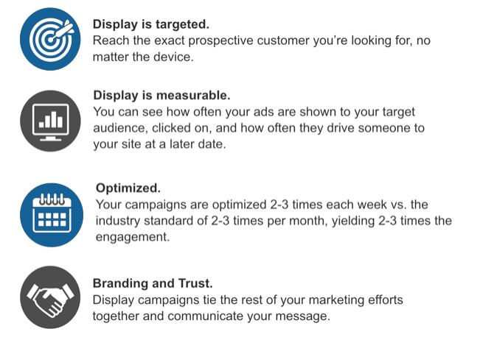
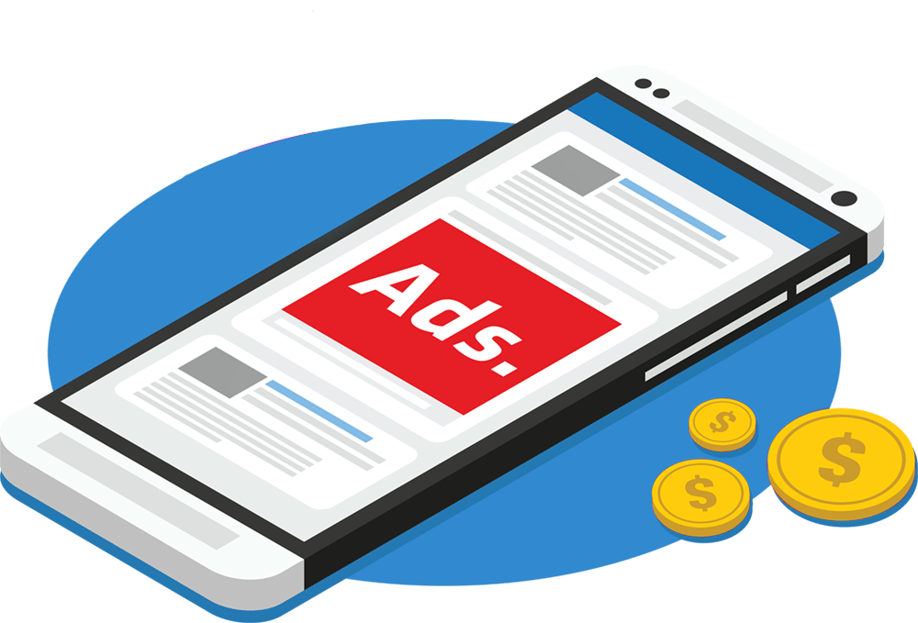
Display Advertising
Reach the right audience of potential applicants to brand your business and build awareness of your open positions.
Reach more people in more places online.
applicants
Display ads can help you promote your business when people are browsing online, watching YouTube videos, checking Gmail, or using mobile devices and apps.
Target people anywhere, anytime, on any device.
• Mobile/Desktop
• Dynamic
• Geographic
• Retargeting
• Native
• Demographic
• Behavioral
• Category Contextual
• Keyword Contextual
• CRM Targeting

Slide 14


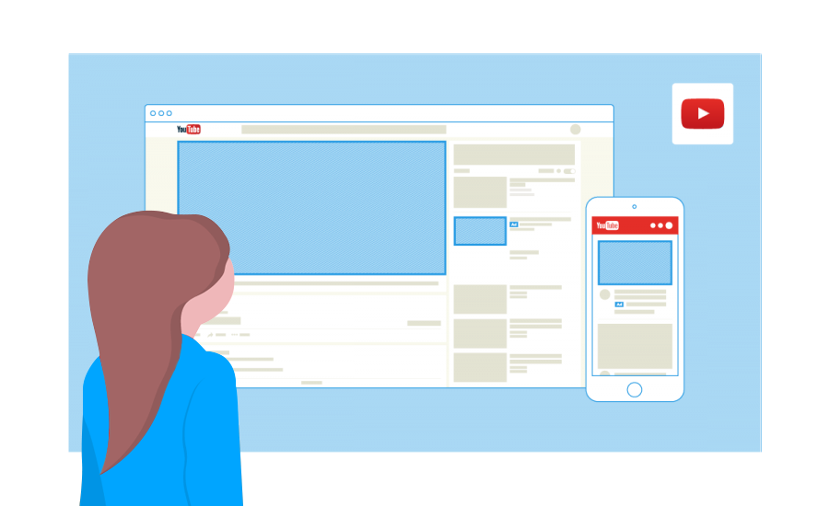
Reach Potential Applicants Where They’re Watching
Use Google’s in-market audiences to target users who are looking for employment in specific industries. Or use affinity audiences to target users based on their interests and habits. YouTube connects you to the people who matter most to your business.
Use the power of video to showcase the benefits of working for your company and highlight your open positions.
800%
70%
4X
Show Up When It Counts
Recruitment agencies are reporting 800% more engagement with job ads that have video embedded
Over 70% of viewers say that YouTube makes them more aware of new brands.
Viewers are 4x more likely to use YouTube versus other platforms to find information about a brand, product, or service.
Turn viewers into applicants, on any budget. YouTube Ads uses Google data to serve your message to the right people at the right moment.
See The Results You Want
YouTube Ads make it easy for people to choose your business. Get more website traffic and applicants.

Slide 15
Thank You

